Slide 1

Data Mining and Machine Learning project
Universita degli Studi di Napoli Federico II Dipartimento di Ingegneria Elettrica e delle Tecnologie dell’Informazione
Master Degree in Data Science
Professors:
Prof.ssa Roberta Siciliano
Prof. Giuseppe Longo
Prof. Andrea Apicella
Presented by: Souha Aouididi
Lorenzo Bove

Slide 2
Project analysis slide 2
Summary
Context of the project
Exploratory Data Analysis
PROJECT
Support Vector
Machine Model
Convolutional Neural
Network Model
Conclusion

Slide 3
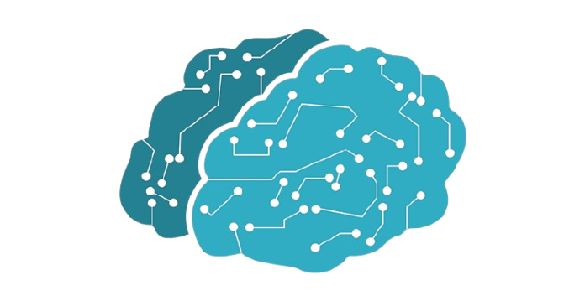
1. Context of the project

Slide 4
Data Description
The dataset we utilized for the project is the Real-world Affective Faces Database (RAF-DB), which contains over 15000 cropped facial images. This is a challenging "real-world" dataset because the images feature great variability in subjects, head poses, lighting, and occlusions (like glasses). Every image is tagged with one of seven primary emotion classes: Surprise, Fear, Disgust, Happy, Sad, Angry, or Neutral.

Slide 5
Objective
Our main goal is to design and test machine learning models for Facial Expression Recognition (FER) using the challenging Real-world Affective Faces Database (RAF-DB). We aim to accurately classify seven core emotions: Surprise, Fear, Disgust, Happy, Sad, Angry, and Neutral. We compare two core approaches:
1. Deep Learning (Custom CNN): We built a Convolutional Neural Network (CNN) from scratch to automatically learn features from the raw image data.
2.Classical Machine Learning (SVM): We used SVM with our extracted features, comparing Linear, RBF, and Polynomial kernels to find the best non-linear boundary.
This project benchmarks these two methods to find the most effective model for real-world emotion classification

Slide 6
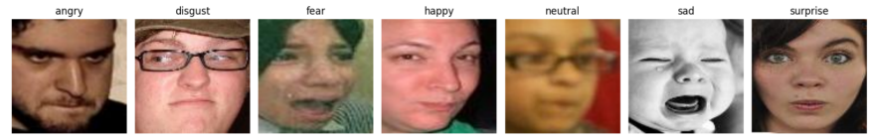
Data Partitioning
The images have been partitioned as follows:
• Training Set: 9,816 images
• Validation Set: 2,455 images (created through an 80/20 stratified split of the original training data to maintain class distribution)
• Test Set: 3,068 images.
Each image has a label representing one of the 7 possible classes
Figure 1: Example of image for each class

Slide 7
2. Exploratory Data Analysis

Slide 8

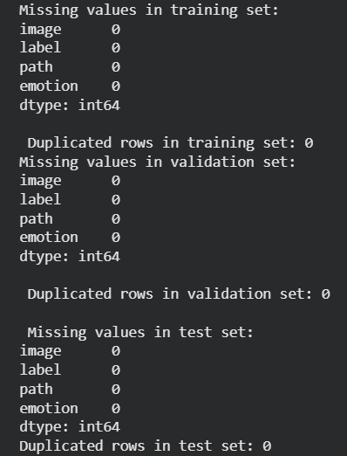


Project analysis slide 5
EDA
Checking dataset info
(missing values & duplicates):
Total number of images:
Images dimensions:
Images formats:

Slide 9
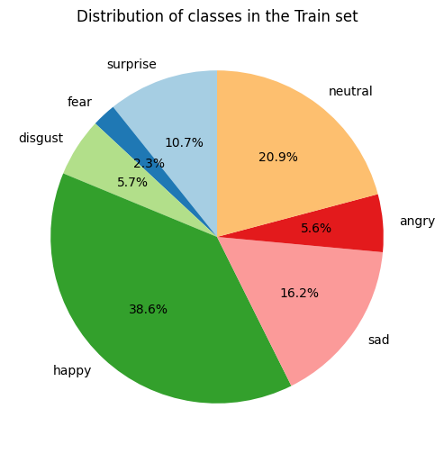
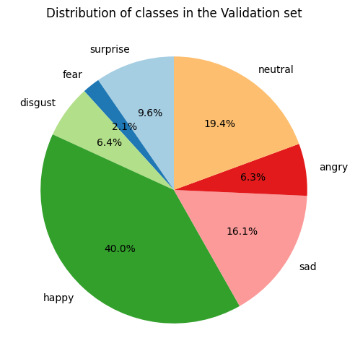
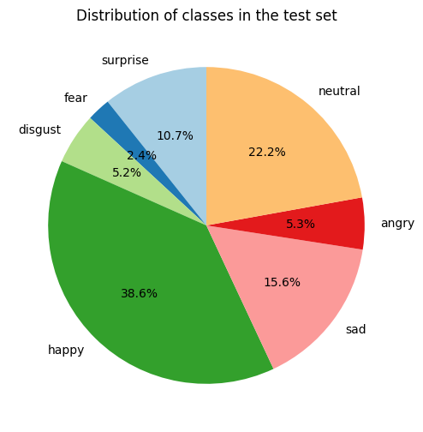
Project analysis slide 5
EDA
Figure 2: Distribution of the 7 classes across the Train, Validation, and Test sets
As we can see the distribution is almost similar in the three sets. However, there is a problem of unbalanced classes that has to be fixed in future steps

Slide 10
2. Support Vector Machine (SVM)

Slide 11
Project analysis slide 6
Preprocessing
A Support Vector Machine (SVM) is a classification algorithm that identifies the optimal hyperplane to separate data points into distinct classes.
The preprocessing steps for the SVM model were critical for handling the image data's complexity and high dimensionality:
Data Preparation and Feature Extraction: This combined step prepared the image data for the SVM. It involved Data Loading and Image Resizing to a standard 48 x 48 format, followed by Image Normalization. A Data Generator was configured for Batch Iteration, which facilitated the Label Decoding and Image Flattening where 3D image arrays were reshaped into flat, 1D feature vectors suitable for the SVM. For the training set specifically, Training Set Rebalancing was performed, culminating in the Data Aggregation of the final feature sets.
Dimensionality Reduction (PCA): Principal Component Analysis (PCA) was then applied to the extracted features. This step drastically reduced the input feature space to only 100 components, which accelerated the SVM training process and mitigated the curse of dimensionality, leading to a more robust and generalized model.

Slide 12
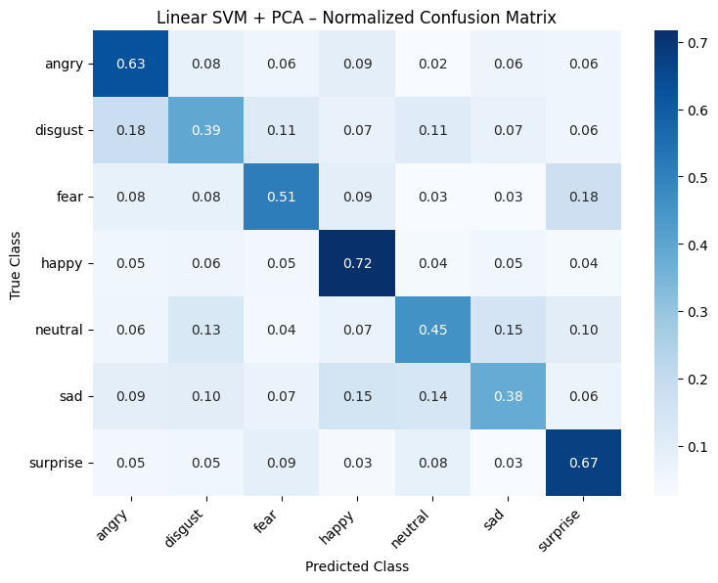
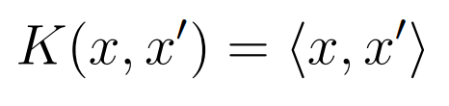
Project analysis slide 6
Linear Kernel SVM
The Linear SVM model's accuracy was low because it treats pixels independently, failing to capture the hierarchical features of image data. The confusion matrix revealed specific errors, mainly confusing 'Fear' with 'Surprise' and 'Disgust' with 'Angry.' This limited performance was an anticipated result of using a basic SVM for a complex image classification task.
Figure 3: Normalized Confusion Matrix of the SVM with Linear kernel
Notes:
In the linear kernel the hyperplane is represented by a straight line,

Slide 13
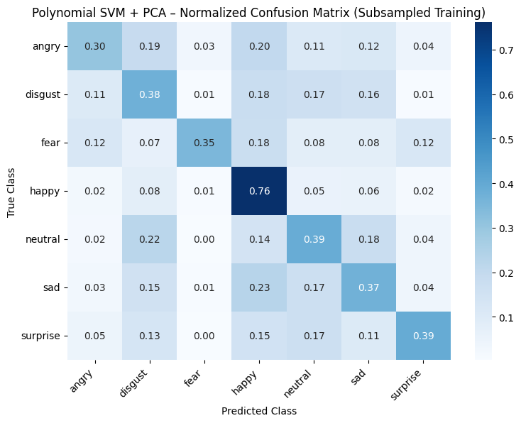

Project analysis slide 6
Polynomial (SVM)
The Polynomial SVM confusion matrix shows high performance for 'Happy' (0.76 recall) but suffers from a significant bias, frequently misclassifying other emotions as 'Happy.' The 'Angry' class was the most challenging to identify (lowest recall of 0.30), being highly confused with both 'Disgust' and 'Happy'. This indicates that the non-linear kernel still struggles to resolve the subtle feature overlaps among negative expressions
Figure 4: Normalized Confusion Matrix of the SVM with Polynomial kernel

Slide 14
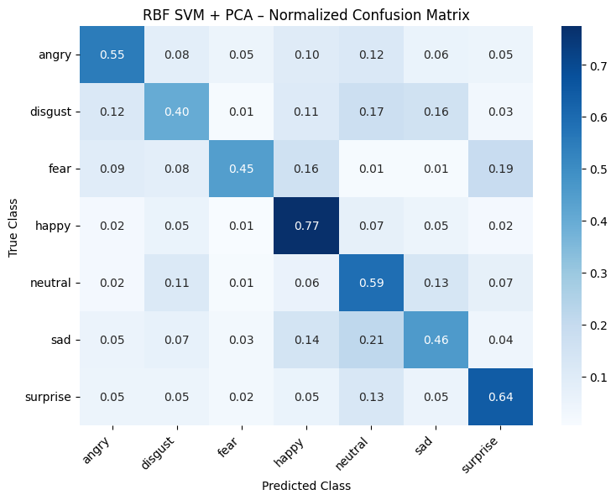
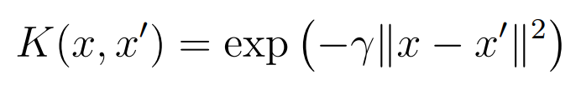
Project analysis slide 6
RBF (SVM)
The RBF SVM effectively classified distinct emotions like 'Happy' (0.77 recall), confirming the kernel successfully handled non-linear boundaries. However, it struggled with visually similar expressions, frequently confusing the minority class 'Disgust' ($0.40$ recall) with 'Neutral' or 'Sad' and misclassifying 'Fear' as 'Surprise.'
Figure 5: Normalized Confusion Matrix of the SVM with RBF kernel

Slide 15
Project analysis slide 6
RBF (SVM)
To understand why the RBF SVM was making specific errors, we applied the Fuzzy Score Membership Analysis. This technique visualizes the model's raw decision function outputs for all classes, and what we did was randomly retrieve a misclassified image from the dataset and analyze its scores.

Slide 16
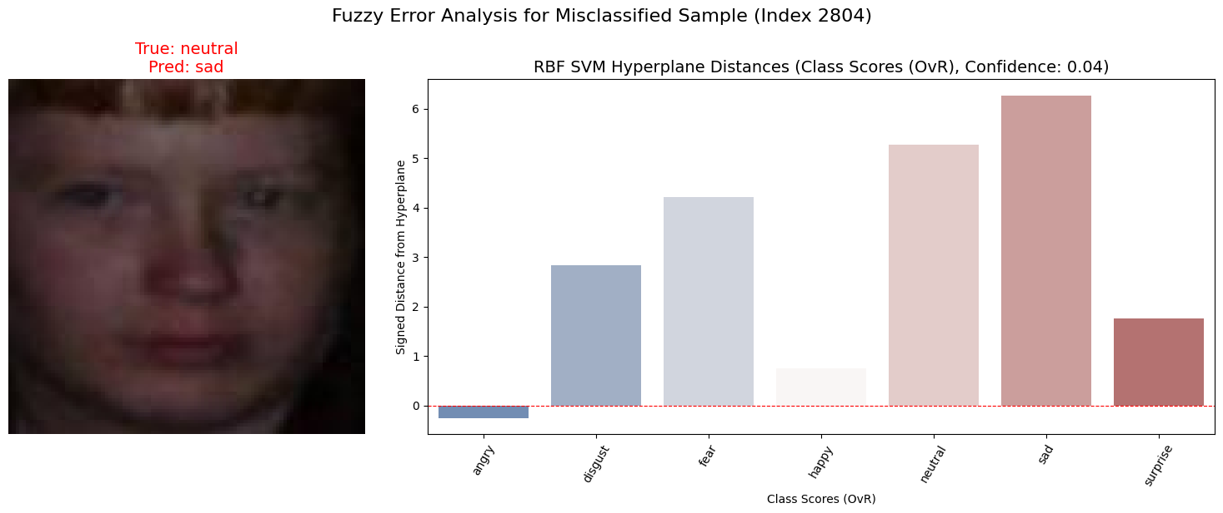
Project analysis slide 6
RBF (SVM)
Figure 6: Fuzzy scores for the image n.2804 of SVM with RBF kernel
The fuzzy score analysis of the misclassified 'Neutral' sample (predicted 'Sad') confirmed the error was a "close call" The model was highly confused, assigning a score of ~6.2 to 'Sad' but a nearly equal score of ~5.3 to the true class 'Neutral.' This indicates the decision boundary between 'Sad' and 'Neutral' was only marginally crossed.
Notes:
, confirming that classification failures were typically "close calls" where the true and predicted classes received nearly equal confidence scores

Slide 17
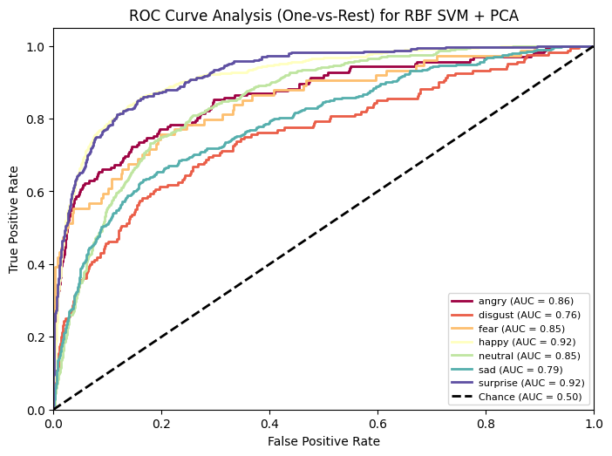
Project analysis slide 6
ROC Curve (RBF)
The RBF SVM ROC curve shows excellent AUCs for distinct emotions like 'Happy' and 'Surprise' (both 0.92). However, negative emotions clustered closer to the diagonal, with 'Disgust' (0.76 AUC) and 'Sad' (0.79 AUC) performing lowest. This confirms that despite the RBF kernel's benefits, feature space overlap limits separation for these specific negative expressions.
Figure 7: ROC Curve of the SVM with RBF kernel

Slide 18
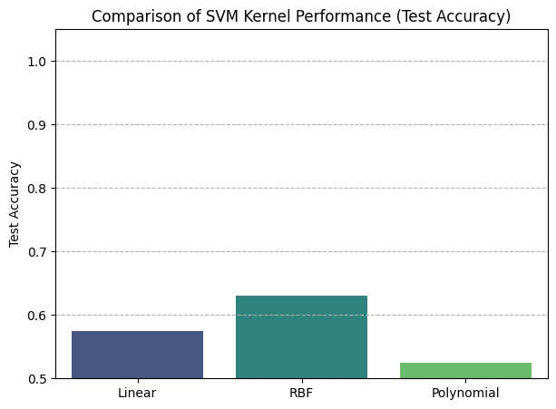
Project analysis slide 6
SVM Models Comparison
Figure 8: Bar chart of the test accuracies for the 3 SVM models

Slide 19
4. Convolutional Neural Network (CNN)

Slide 20
Project analysis slide 6
Preprocessing
A Convolutional Neural Network (CNN) is a deep learning model that automatically learns spatial features from images using convolutional layers.
The CNN preprocessing focused on balancing data and preventing overfitting:
Class Balancing (Random Oversampling): We used Random Oversampling on the training set to address class imbalance, ensuring a balanced input distribution for the model.
Data Augmentation: Real-time Data Augmentation (including rotation, shifts, zoom, and flips) was applied to the training images to artificially expand the dataset and improve model generalization against overfitting.
Generator Configuration: Data Generators streamed normalized images at 100x100 pixels resolution, using shuffling for training and fixed order for evaluation.

Slide 21
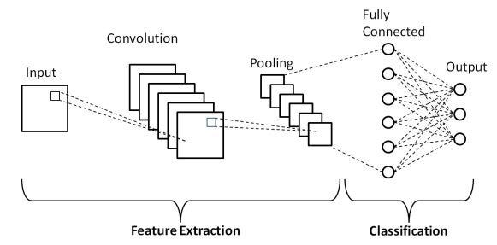
Project analysis slide 6
CNN Architecture
The CNN is a Sequential model for 100x100 inputs, using a pyramidal design.
Feature Extraction: Four blocks apply Conv2D, Batch Norm, ReLU, and MaxPooling, progressively doubling filters (32 to 256) to extract features.
Classification Head: Features are flattened, passed through a 512-neuron dense layer (with Batch Norm and ReLU), followed by 0.3 Dropout for regularization.
Output: The final layer uses Softmax across the 7 emotion classes.

Slide 22
Project analysis slide 6
Optimization, Training Stabilization
and Training Configuration
Optimization strategies ensured stable and efficient learning:
Batch Normalization: Used extensively to stabilize gradients and counteract Internal Covariate Shift, allowing for faster training and reducing sensitivity to initialization.
Adam Optimizer: Employed with a learning rate of η = 0.0005. Adam computes adaptive learning rates for each parameter, ensuring generally faster convergence, especially with noisy gradients.
Training Configuration:
• Optimizer: Adam with learning rate 0.0005.
• Loss Function: Categorical Crossentropy.
• Epochs: 50.
• Callbacks: Early Stopping and Learning Rate Reduction on Plateau

Slide 23
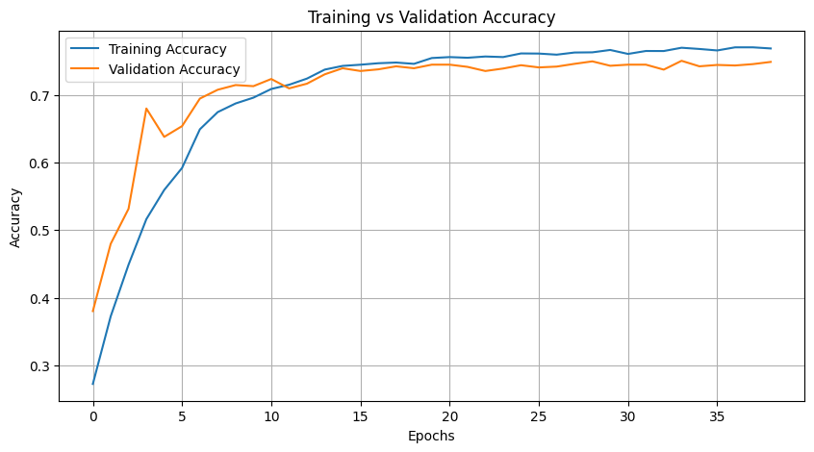
Project analysis slide 6
Training vs Validation
Accuracy (CNN)
The training history shows rapid performance increase in the first 10 epochs, stabilizing around epoch 20. The model achieved high final accuracy ( ~76 training, ~ 75\% validation). Crucially, the minimal gap between the curves confirms good generalization and no significant overfitting, thanks to the use of Batch Normalization and Dropout.
Figure 9: Train accuracy vs Validation accuracy for the CNN

Slide 24
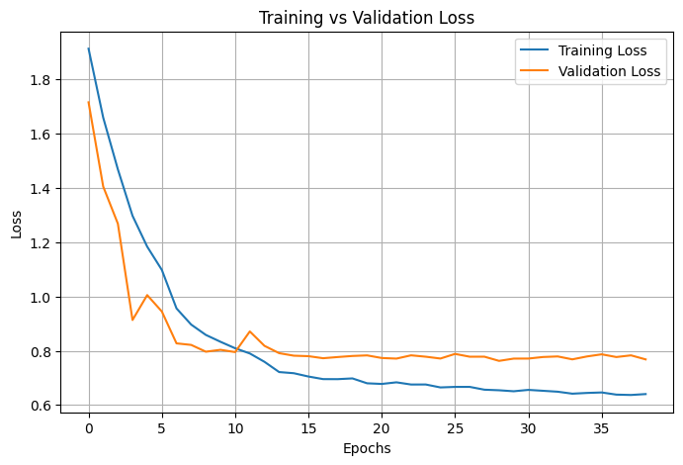
Project analysis slide 6
Training vs Validation
Loss (CNN)
The loss graph shows a steep decline for both sets in the first 15 epochs, confirming effective feature learning. Training loss stabilized near 0.65 while validation loss plateaued around 0.80. Although a slight generalization gap exists, the stable validation loss confirms the model maintains good robustness without degrading performance.
Figure 10: Train loss vs Validation loss

Slide 25
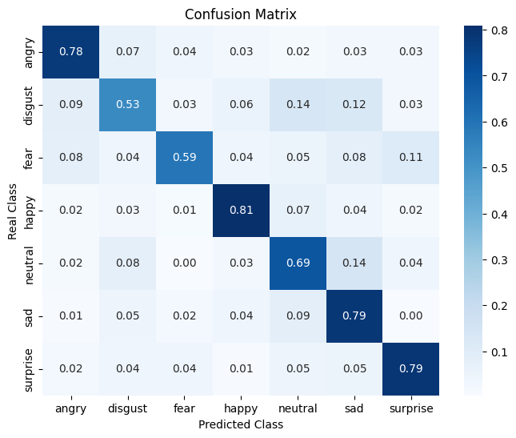
Project analysis slide 6
CNN Confusion
matrix
The CNN confusion matrix shows high recall for distinct emotions like 'Happy' (highest), 'Surprise', 'Sad', and 'Angry'. Performance drops significantly for 'Disgust' (lowest recall) and 'Fear', which are often confused with other classes like 'Neutral' and 'Sad'. This highlights the CNN's difficulty in resolving subtle feature overlap between ambiguous and under-represented emotional states.
Figure 11: Normalized Confusion Matrix for the 7 emotion classes OF THE CNN

Slide 26
Project analysis slide 6
Saliency Map
To understand which image regions the CNN used for classification, we applied the Saliency Map visualization. This technique computes the gradient of the class score with respect to input pixels, identifying the most discriminative regions. What we did was apply the Saliency Map to a correctly classified image (for example 'sad') and analyze the heatmap.

Slide 27
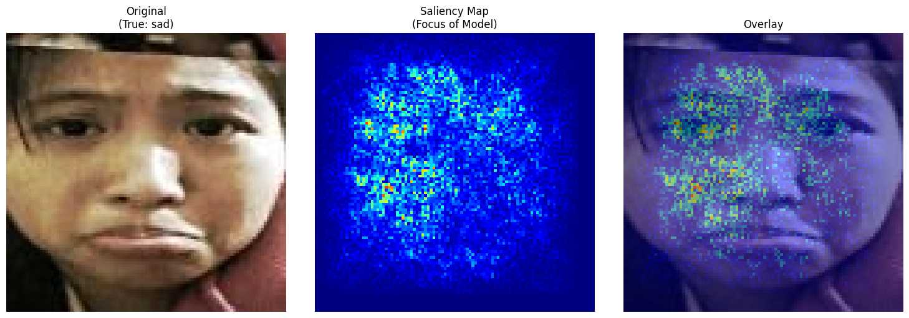
Project analysis slide 6
Saliency Map
Figure 12: Saliency Map visualization for a sample classified as ’sad’. Left: Original image. Center: Saliency heatmap. Right: Overlay
The Saliency Map visualization confirmed that the CNN's focus was accurately concentrated on key physiognomic areas, specifically the eyes and mouth curvature, which are the facial landmarks associated with the classified emotion ('sad'). The low activation in the background confirms the model learned to extract only the discriminative facial patterns.

Slide 28
5. Conclusion

Slide 29
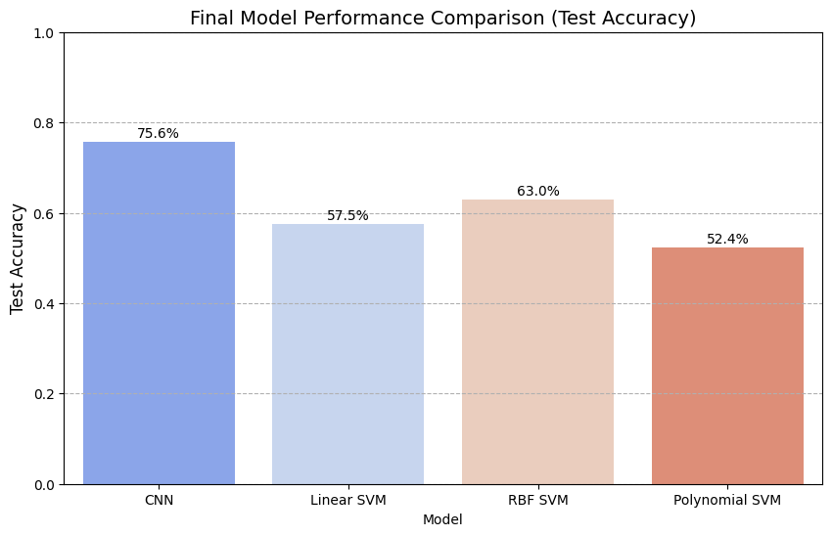
Project analysis slide 11
CNN vs SVM models
comparison
The results clearly show the proposed CNN significantly outperformed all SVM variants, achieving the highest test accuracy of 75.6%. Among the traditional classifiers, the RBF SVM was the most competitive, reaching 63.0%, but still lagged the CNN by over 12%. The Linear (57.5%) and Polynomial (52.4%) SVMs performed the poorest.
Figure 13: Final performance comparison (Test Accuracy) between the proposed CNN and SVM baselines

Slide 30
Conclusion
This project successfully compared classical Support Vector Machines (SVMs) and a custom Convolutional Neural Network (CNN) for Facial Expression Recognition (FER).
The results decisively favored the deep learning approach: the custom CNN achieved 75.6% test accuracy, significantly outperforming the best SVM variant (RBF kernel, 63.0%). This gap demonstrates the CNN's advantage in automatically learning complex, hierarchical feature representations from high-dimensional pixel data, a task where traditional SVMs relying on fixed features struggled.

Slide 31
Thank You

